Slide 1

Turbo C++: An Introduction
Turbo C++ is a powerful and widely-used C++ programming environment that has been a staple of software development since the early 1990s. With its user-friendly IDE, extensive libraries, and robust compiler, Turbo C++ provides a comprehensive solution for creating a wide range of applications.

Slide 2


History and Evolution of Turbo C++
1
1987
Turbo C++ is first introduced by Borland as a major update to their popular Turbo C compiler.
2
1992
Turbo C++ 3.0 is released, adding support for C++ and object-oriented programming.
3
2006
Embarcadero acquires Borland and continues to support and update Turbo C++ for modern systems.

Slide 3
Turbo C++ Integrated Development Environment (IDE)
Code Editor
Debugger
Project Management
The Turbo C++ IDE provides a robust code editor with syntax highlighting, code completion, and other productivity features.
The built-in debugger allows developers to step through their code, set breakpoints, and easily identify and fix issues.
Turbo C++ makes it easy to manage multiple projects and files, with tools for compiling, linking, and deploying applications.

Slide 4
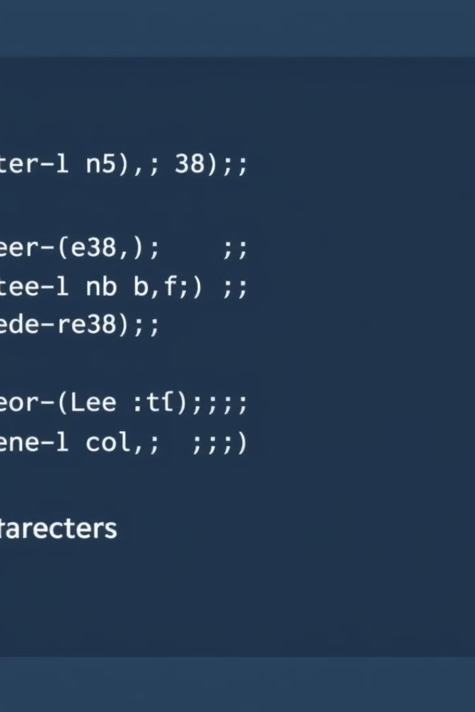
Data Types and Variables in Turbo C++
1
Primitive Data Types
2
Variable Declarations
Turbo C++ supports a wide range of primitive data types, including integers, floating-point numbers, characters, and booleans.
Variables in Turbo C++ are declared using the appropriate data type, with options for local, global, and static variables.
3
Dynamic Memory Allocation
Turbo C++ provides functions like `malloc()` and `free()` for dynamically allocating and deallocating memory as needed.

Slide 5
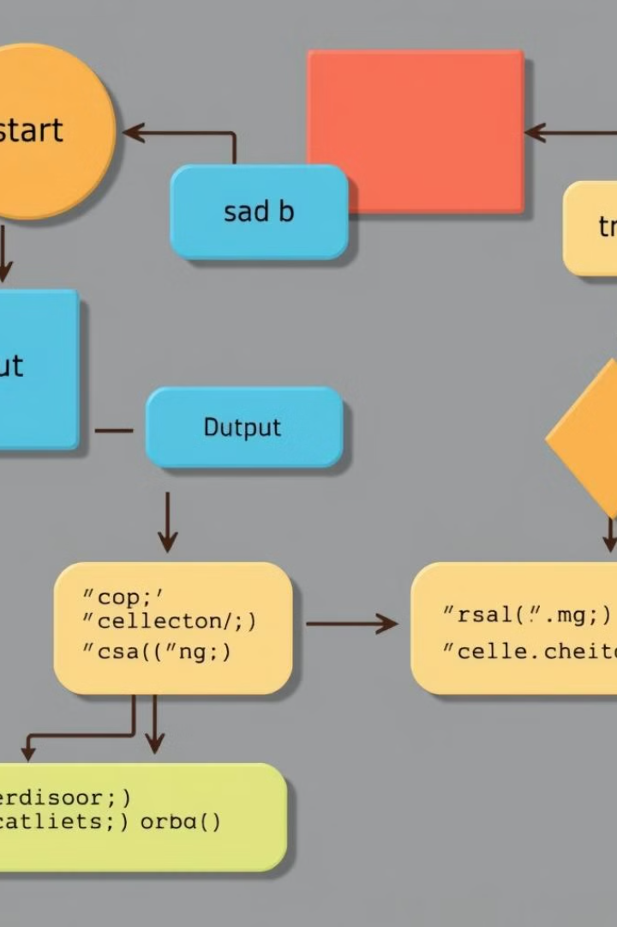



Control Structures: Conditionals and Loops
If-Else
Conditional statements like `if-else` allow your program to make decisions based on various conditions.
Loops
Turbo C++ supports a variety of loop structures, such as `for`, `while`, and `do-while`, to execute code repeatedly.
Switch Statement
The `switch` statement provides a concise way to handle multiple conditional cases.

Slide 6
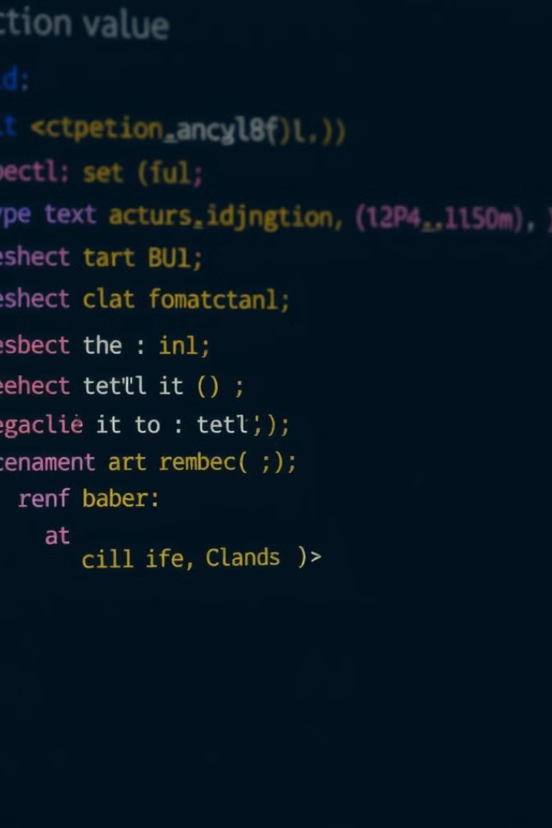



Functions and Subroutines in Turbo C++
Function Definitions
Functions in Turbo C++ are defined with a return type, a name, and a set of parameters.
Function Calls
Functions are called by passing the required arguments, and the function's return value can be used in the program.
Scope and Visibility
Turbo C++ supports local, global, and static variables, each with their own scope and visibility rules.

Slide 7

File I/O and Handling in Turbo C++
File Streams
File Operations
Turbo C++ provides file stream objects like `ifstream` and `ofstream` for reading from and writing to files.
Common file operations in Turbo C++ include opening, closing, reading, and writing files, as well as file positioning and error handling.
Binary I/O
Turbo C++ also supports binary file I/O, allowing you to read and write data in a more efficient, machine-readable format.

Slide 8

Conclusion and Resources
Turbo C++ is a powerful and versatile programming environment that has stood the test of time. With its comprehensive IDE, extensive libraries, and robust compiler, it remains a popular choice for developing a wide range of applications. To learn more, explore the wealth of online tutorials, documentation, and community resources available for Turbo C++.
Presentation by :
Chintan Varma -2404030400120
Yash Panchal -2404030400247

